Slide 1
Radiology Image Classification
IST 718 Final Project Presentation - Group 2
Matthew Pergolski
Meichan Huang
Shawn Anderson

Slide 2
Agenda
Background of the project
Project Goals
Data Description
Data Modeling
Model 1
Fastai
PyTorch
Resnet 18, 50, 152
Model 2
Tensorflow/Kera
VGG16
Results
Recommendation/Summary

Slide 3
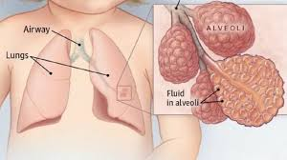
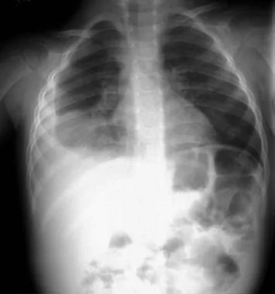
Background
Pneumonia is a respiratory infection caused by bacteria or viruses.
It affects many individuals, with high levels of pollution, unhygienic living conditions, and overcrowding are relatively common, together with inadequate medical infrastructure.
Pneumonia causes pleural effusion, a condition in which fluids fill the lung, causing respiratory difficulty.
Early diagnosis of pneumonia is crucial to ensure curative treatment and increase survival rates.
Chest X-ray imaging is the most frequently used method for diagnosing pneumonia.
The examination of chest X-rays is a challenging task and is prone to subjective variability.
Note: Kundu R, Das R, Geem ZW, Han GT, Sarkar R. Pneumonia detection in chest X-ray images using an ensemble of deep learning models. PLoS One. 2021 Sep 7;16(9):e0256630. doi: 10.1371/journal.pone.0256630. PMID: 34492046; PMCID: PMC8423280.
Right lower lobe consolidation in a patient with bacterial pneumonia

Slide 4
Project Goals
Develop a classification model for accurately classifying chest x-ray images into “normal” and “pneumonia” ​
Develop reliable auto-screening of X-Rays for pneumonia in the medical field
Enhance the efficiency in identifying pneumonia or pneumonia-like X-ray and help doctors

Slide 5
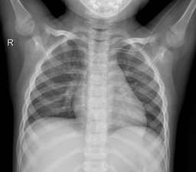
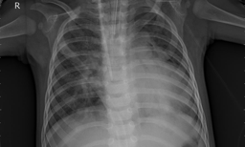
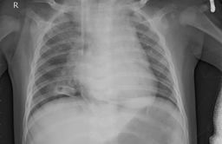
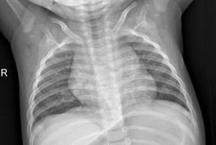
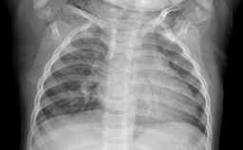
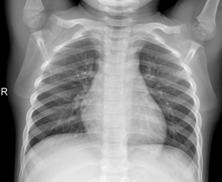
Business question(s)​
How accurately can we predict pneumonia?
What is the model that best identify/predicts the pneumonia vs. normal lung x-rays?
What are the respective accuracy in the models?
Normal Lungs
Pneumonia

Slide 6
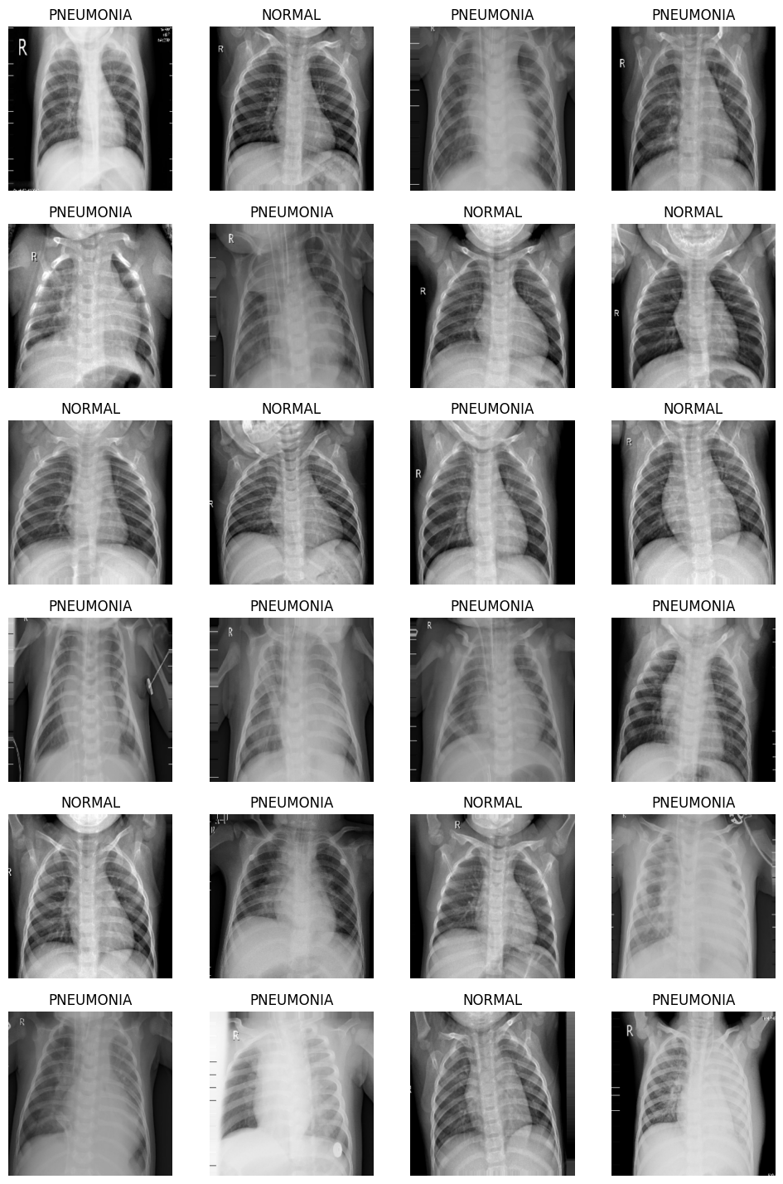
Dataset
Data source: https://www.kaggle.com/datasets/paultimothymooney/chest-xray-pneumonia​
Data description:​
5856 chest x-ray images in total​
Pediatric patients of 1-5 years old​
Guangzhou Women and Children’s Medical Center in China
Data format: X-ray Images in three datasets (Train, Validation, and Test)

Slide 7
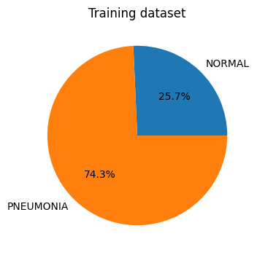
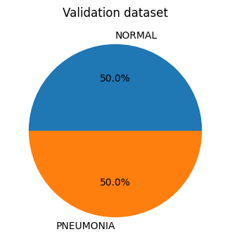
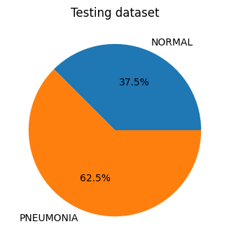
Descriptive Analysis of the Train/Val/Test Data
5216 images
16 images
624 images

Slide 8
Data Analysis: ResNet Modeling

Slide 9

PyTorch
Deep learning python-framework
PyTorch vs TensorFlow
PyTorch for Image Classification

Slide 10

Fastai
Why fastai?
Fastai for Image Classification
Fastai and PyTorch

Slide 11
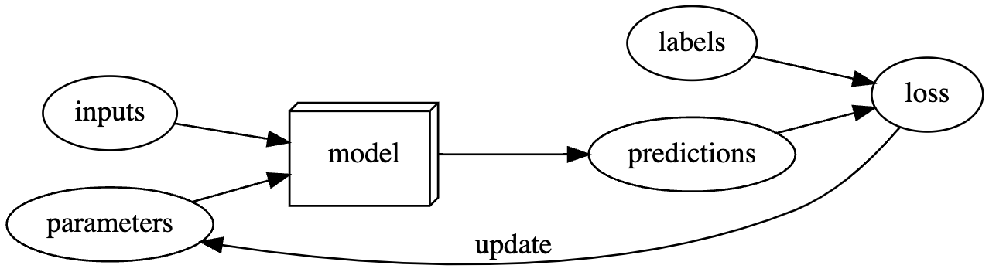
Models | Framework
Backpropagation
What is it?
How does it work?
Why is it important?

Slide 12
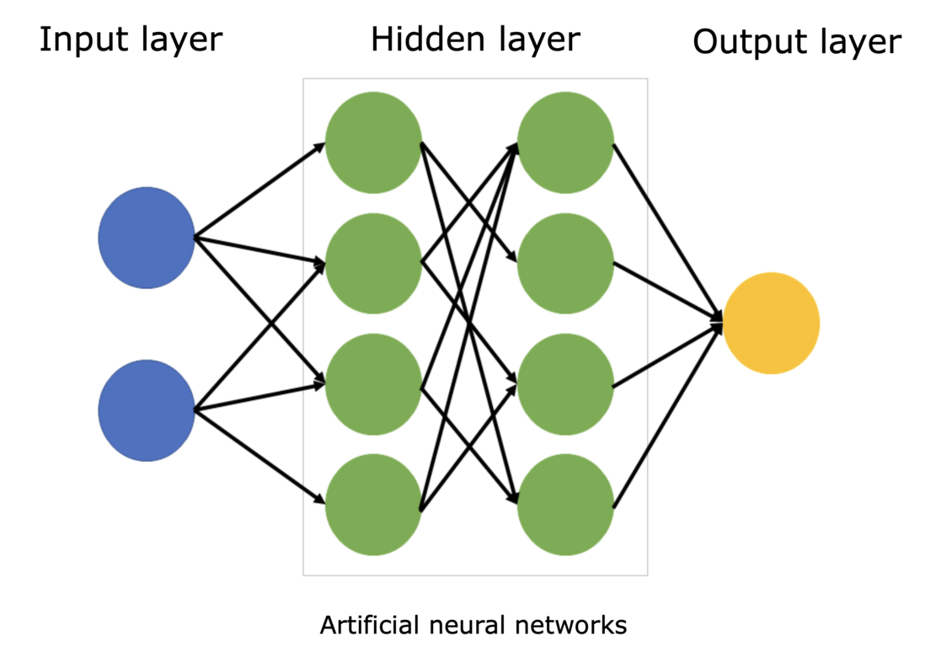
Models
Resnet18
Resnet50
Resnet152

Slide 13
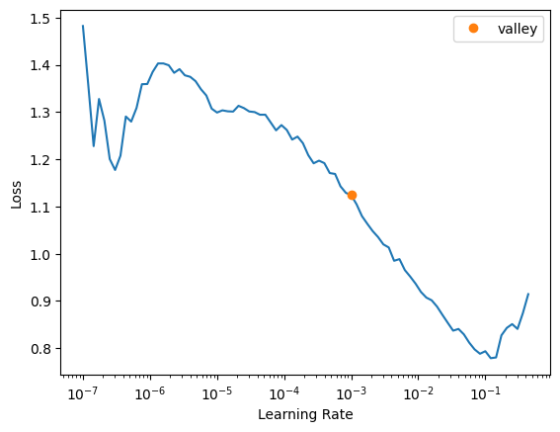
Results for Resnet Modeling
Model | Accuracy
RESNET18 | 84.78%
RESNET50 | 81.89%
RESNET152 | 85.58%
RESNET18 (Learning Rate Optimized) | 85.26%

Slide 14
Data Analysis: VGG-16 Modeling

Slide 15
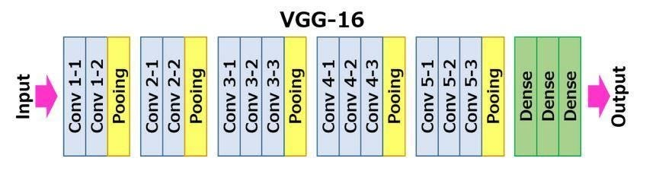
Model 2: VGG 16

Slide 16
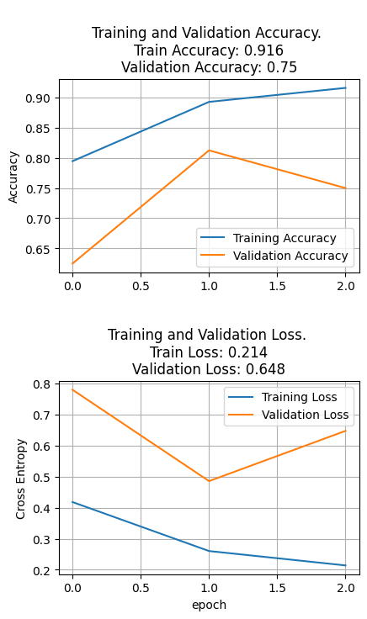
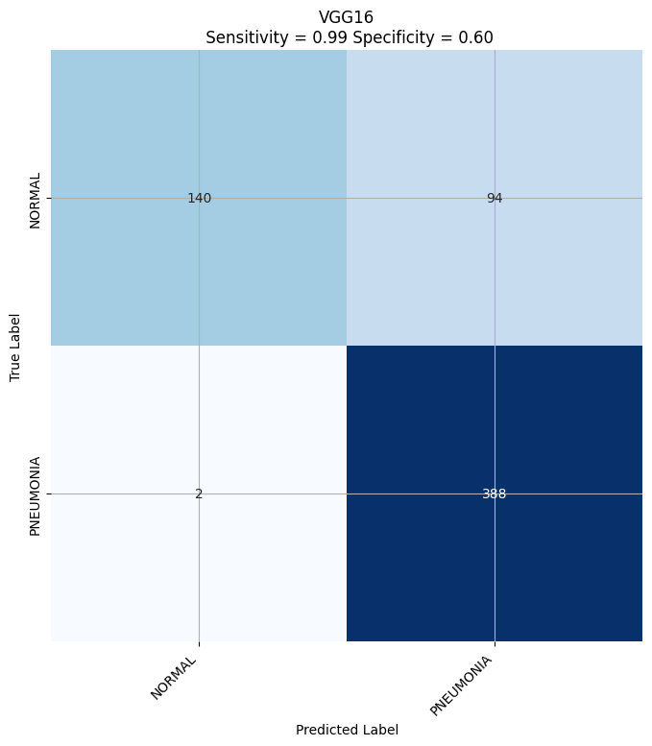
Results from VGG-16 Modeling
Results with training dataset:
163/163 [==============================] - 163s 930ms/step - loss: 0.4182 - accuracy: 0.7947 - val_loss: 0.7801 - val_accuracy: 0.6250
Epoch 2/3
163/163 [==============================] - 159s 975ms/step - loss: 0.2603 - accuracy: 0.8928 - val_loss: 0.4858 - val_accuracy: 0.8125
Epoch 3/3
163/163 [==============================] - 160s 982ms/step - loss: 0.2140 - accuracy: 0.9160 - val_loss: 0.6476 - val_accuracy: 0.7500
Results with test dataset:
20/20 [==============================] - 18s 891ms/step - loss: 0.5482 - accuracy: 0.8413
[0.5482422709465027, 0.8413461446762085]
Accuracy: 84.13%
Loss: 0.548

Slide 17
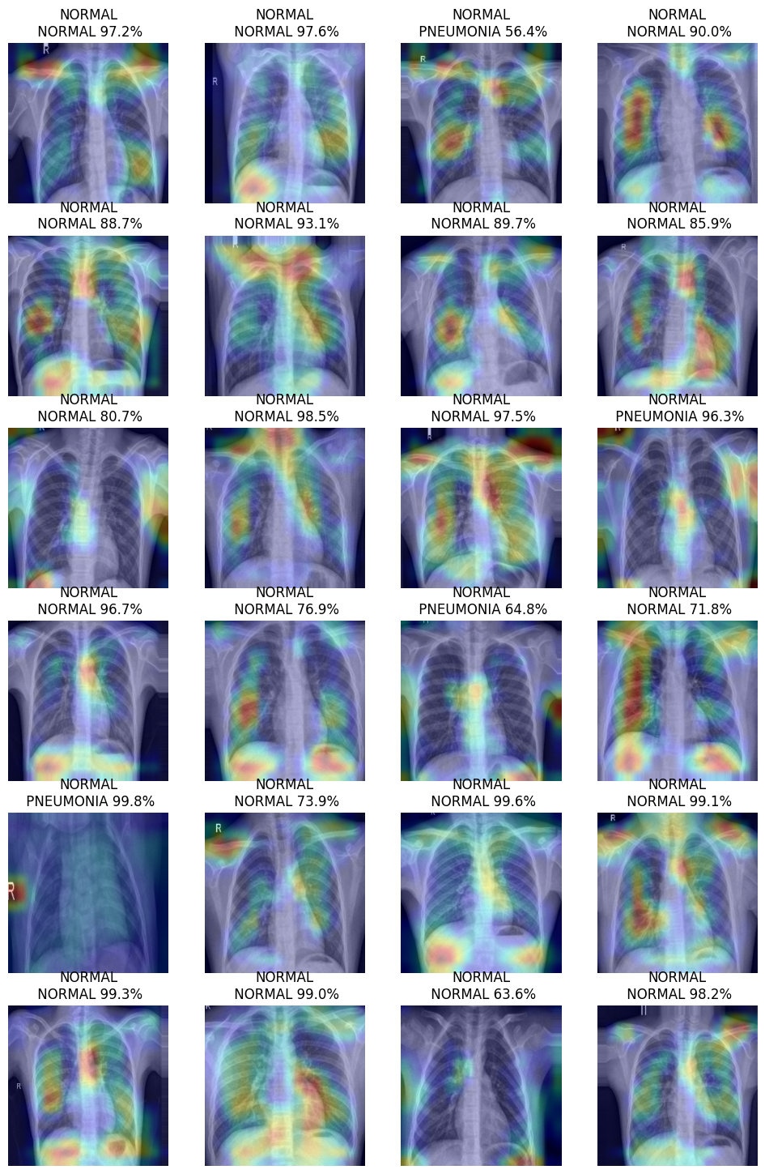
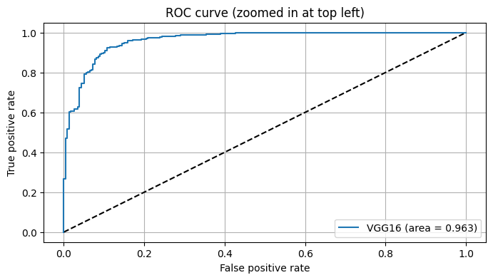
ROC curve for VGG-16 model
The ROC curve showed that VGG-16 model performs nearly perfectly at all classification levels.
Notes:
An ROC curve (receiver operating characteristic curve) is a graph showing the performance of a classification model at all classification thresholds. This curve plots two parameters: True Positive Rate. False Positive Rate.J

Slide 18
Discussion & Implications

